Slide 1
DECENTRALIZED INVESTMENT BANKING
The Case of Discount Dividend-Reinvestment
and Stock-Purchase Plans
Myron S.Scholes, Mark A. Wolfson 1989

Slide 2
CONTENTS
01/Introduction
02/ Characteristics of
Discount Programs
03/ Development
of Investment Program
04/ Decentralized
Investment Banking
05/ Conclusion &
Critics

Slide 3
Terminologies
Investment Strategy
Chapter 1
Research Meaning
研究理论与文献综述
Introduction
主要创新

Slide 4
Terminologies
Introduction
1. What is Dividend-Reinvestment Plan
Characteristics of
Discount DRP
A dividend reinvestment plan (DRIP) is a plan is offered by a corporation that allows investors to reinvest their cash dividends into additional shares or fractional shares of the underlying stock on the dividend payment date.
Development
of Investment Program
Decentralized Investment Bank
Conclusion
Critics
Notes:
Long term, the biggest advantage is the effect of automatic reinvestment on the compounding of returns. When dividends are increased, shareholders receive an increasing amount on each share they own, which can also purchase a larger number of shares. Over time, this increases the total return potential of the investment. Because more shares can be purchased whenever the stock price decreases, the long-term potential for bigger gains is increased.

Slide 5
Terminologies
Introduction
2. What is Discount Stock-Repurchase Plan
Characteristics of
Discount DRP
DSRP allow existing shareholders to purchase new shares from company at a discount, usually between 1%-10% and also free of commissions.
Development
of Investment Program
1%-10% discount of current share price
No Commissions
Decentralized Investment Bank
Conclusion
Critics
Notes:
Long term, the biggest advantage is the effect of automatic reinvestment on the compounding of returns. When dividends are increased, shareholders receive an increasing amount on each share they own, which can also purchase a larger number of shares. Over time, this increases the total return potential of the investment. Because more shares can be purchased whenever the stock price decreases, the long-term potential for bigger gains is increased.

Slide 6
Investment Strategy
Introduction
Hold one share of company stock
Sign up to participate in the discount stock-purchase program
Mail in a check for discounted stock periodically
Receive the discount shares free of commissions and sell them right away
Reinvestment the dividends
For example:
J.P Morgan: $5000 each month with a discount of 5.263%
Sure profit by selling: $5000* 5.263%=$263.16
12-months compound return:
Exceeds 85% of the monthly investment!
Characteristics of
Discount DRP
Development
of Investment Program
Decentralized Investment Bank
Conclusion
Critics

Slide 7
Research Meaning
Introduction
Characteristics of
Discount DRP
Another anomaly against efficiency market theory
Understand the reasons for the fading of DDRIP
Development
of Investment Program
Decentralized Investment Bank
Is DSPP an efficient way of raising capital?
What’s the economic reason behind DDRIP?
Conclusion
Critics

Slide 8
Industry Concentration
Investment Ceiling & Discount
Chapter 2
Calculate actual discount
研究理论与文献综述
Characteristics of
Discount Program
主要创新

Slide 9
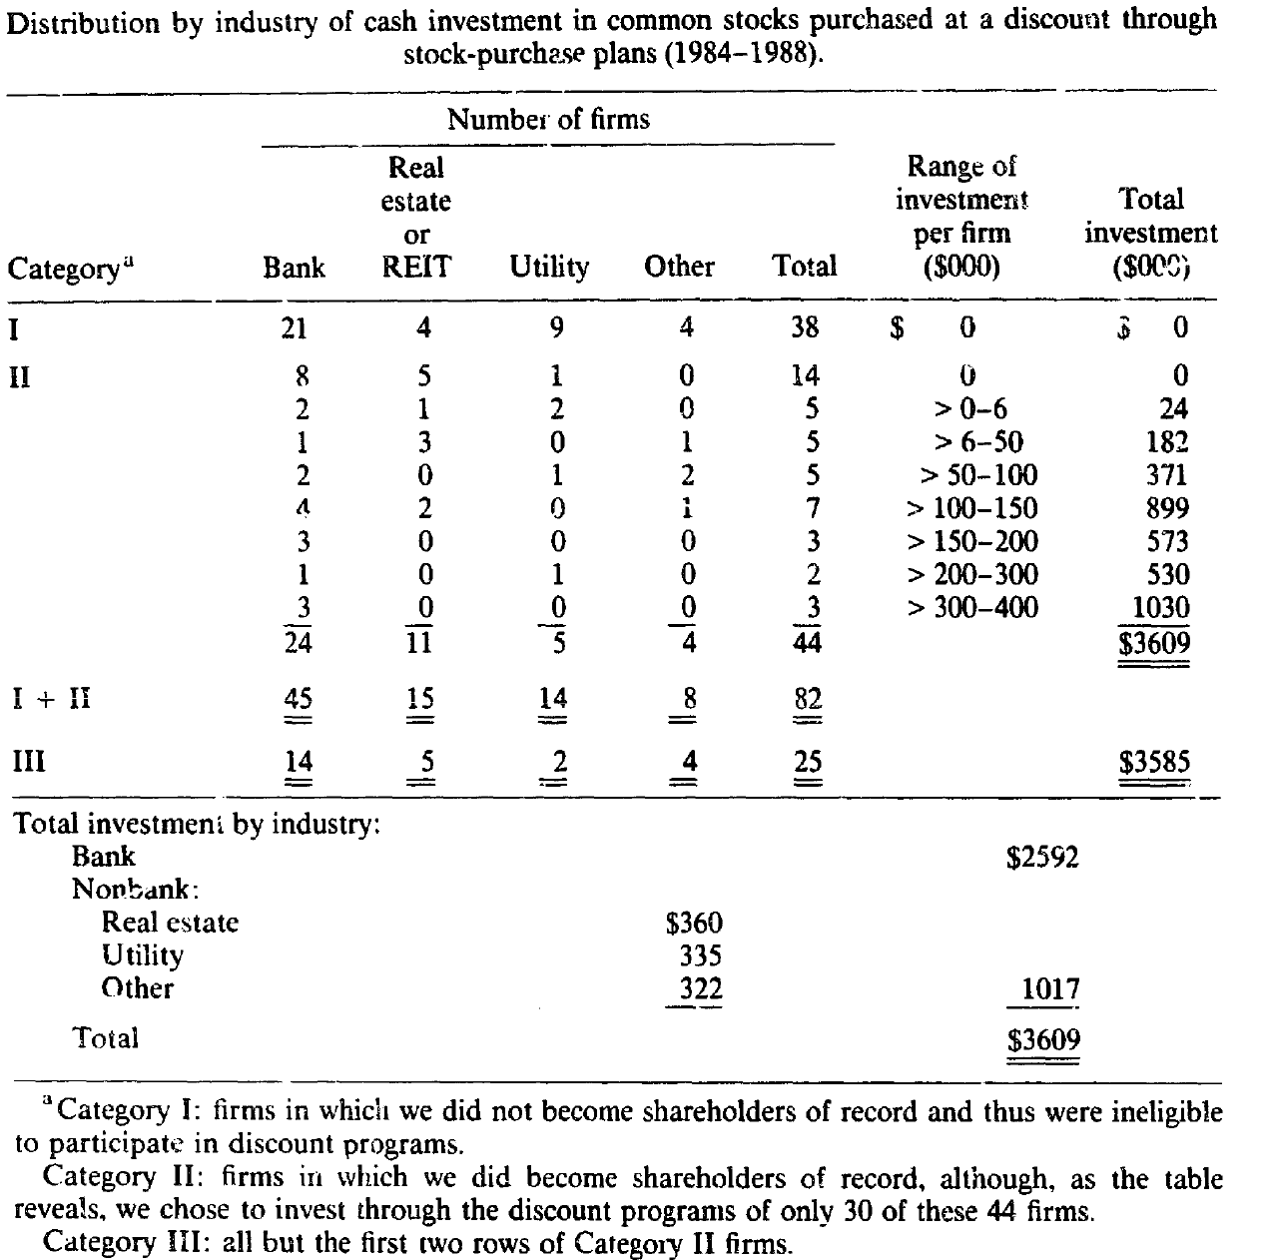
Industry Concentration
Introduction
Characteristics of
Discount DRP
74 of the 82 plans are:
Banking (45),
Real Estate &REIT (15),
Public Utilities (14).
$2.6 million of $3.6 million are invested in banking
Development
of Investment Program
Decentralized Investment Bank
Conclusion
Critics

Slide 10
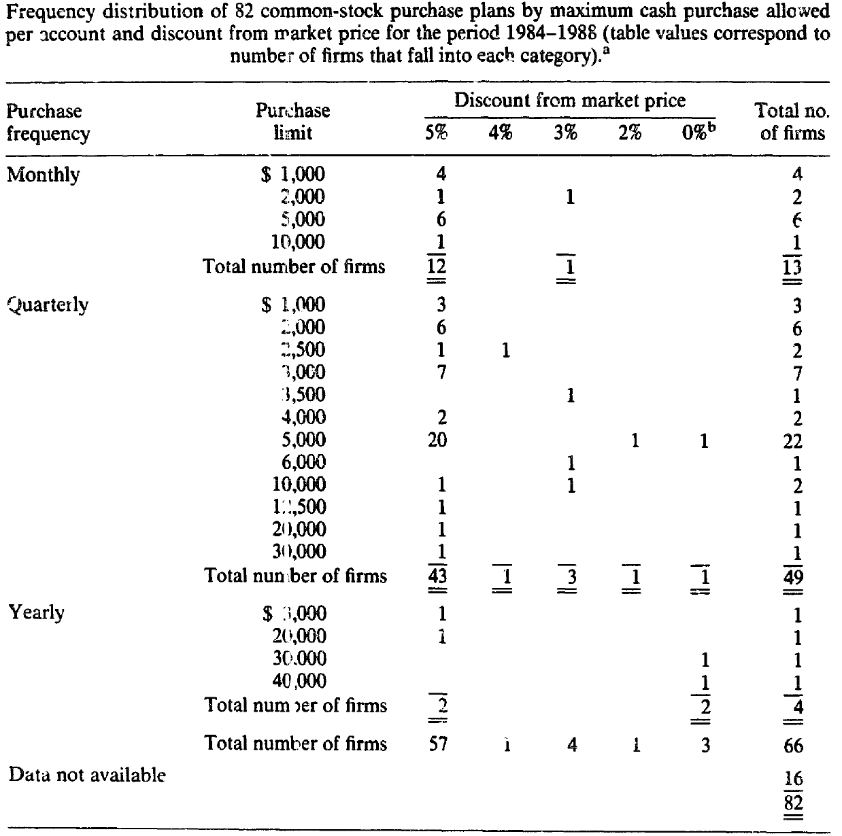
Investment Ceiling and Discounts
Introduction
Ceiling and discount change:
Chasebrough Ponds: $5000 to $1000
CSX: $5000 per quarter to $1500 per month
First Union: $500 tp $10,000 per quarter
Several banks drop from 5% to 3%
BOA: 5% to 2% monthly, and $10,000 to
Characteristics of
Discount DRP
Development
of Investment Program
Decentralized Investment Bank
Conclusion
Critics

Slide 11
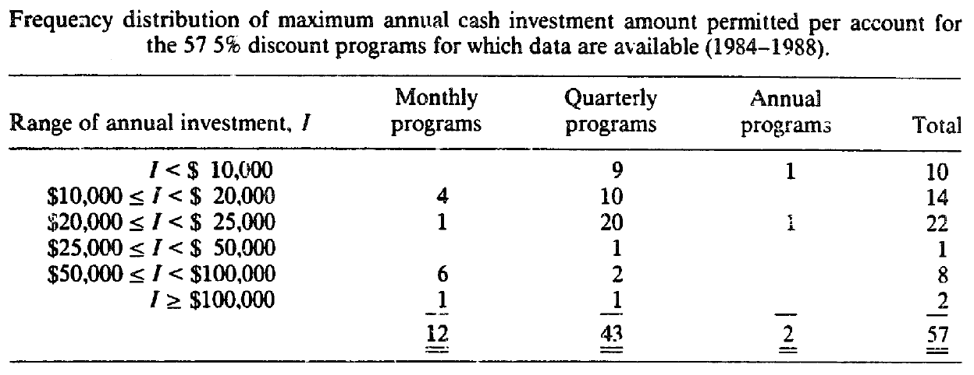
Investment Ceiling and Discounts
Introduction
Characteristics of
Discount DRP
Development
of Investment Program
Decentralized Investment Bank
Conclusion
Critics

Slide 12
Calculate Actual Discount Received
Introduction
How’s the actual sales prices determined?
Number of days prices factored in: (option allowed)
1-20 days;
First Chicago: 5-days average of high and low price
Trading price used:
Last trading price;
Avg(high and low)
Avg(Closing bid & ask price)
Average period ends on days
Advance payment requirement
Characteristics of
Discount DRP
Development
of Investment Program
Decentralized Investment Bank
Conclusion
Critics

Slide 13
Timeline and investment strategy
Insurance
Restriction on Investment accounts
与
Chapter 3
Securing line of credits
Changes in the level of investment over time
Historical Development of the investment program
Strategy performance

Slide 14
Preparation
Introduction
The cost of the strategy:
becoming informed about the plan’s detail
Bearing or avoid undesired market risks
Monitoring the investment
Transaction costs in selling
Comply with margin requirement and tax laws
Source of discount programs:
Standard and Poor’s Cumulative Dividends
Directory of Companies Offering Dividend Reinvestment Plans (April 1984)
Characteristics of
Discount DRP
Development
of Investment Program
Decentralized Investment Bank
Conclusion
Critics

Slide 15
Timeline of strategy
Introduction
Sep. 1984
Purchased single share in each of the ten companies:
<$400, with $33.06 commissions
Nov.
During Dec.
Characteristics of
Discount DRP
First discount investment:
Total of $47,500
Invested $55,000 and begin to search new programs
Development
of Investment Program
Decentralized Investment Bank
Early Oct
Early Dec.
Jan. 1985
Conclusion
Purchased another 15 firms’single share,
total of $300
Received first certificate for shares, find broker to sell promptly
Begin to invest in batch
Critics

Slide 16
Refinement
Introduction
Characteristics of
Discount DRP
Strategic timing of investment (nuance in purchase time/option*)
Batch Process (Eight batches)
Purchase of insurance against price decline
More than eight initial shares so can set up more accounts
Securing of lines of credit at local banks
Development
of Investment Program
Decentralized Investment Bank
Conclusion
Critics

Slide 17
Insurance
Introduction
 | In-the-money put option | Sell short | Macro Hedge (actively traded put options on market index)
Effectiveness | Effective | Effective | Only effective for market risk
Drawbacks | Most Expensive (bid-ask spread and commissions) | Expensive | Can not cover industry/ firm specific risk
 | Time-consuming | Cash and securities as collateral
 | Miss long capital gain | Margin call
 |  | Miss long capital gain
Application | Apply when there’s no significant appreciation |  | All the time
Total loss | Total loss of $27,000 are incurred
Characteristics of
Discount DRP
Development
of Investment Program
Decentralized Investment Bank
Conclusion
Critics

Slide 18
Restriction on investment accounts
Introduction
Economies of scale:
cost of time spent on the learning of learning and implementation
brokerage commissions
So, Is it possible to set up multiple accounts under one person?
Some companies encourage
Some companies restrict and even cancelled this program due to arbitrage
Characteristics of
Discount DRP
Development
of Investment Program
Decentralized Investment Bank
Conclusion
Critics

Slide 19
Securing lines of credit
Introduction
Characteristics of
Discount DRP
Total of $300,000 lines of credits: (<50% of total investment)
$200,000 at prime+1.5%
$100,000 at prime +2%
The credit lines are terminated at the end of 1986, with a total of $14,000 interests and 12% average interest rate in two years.
Idle cash yielded interest of prime-2%, so whenever has idle cash, pay down loan
Development
of Investment Program
Decentralized Investment Bank
Conclusion
Critics

Slide 20
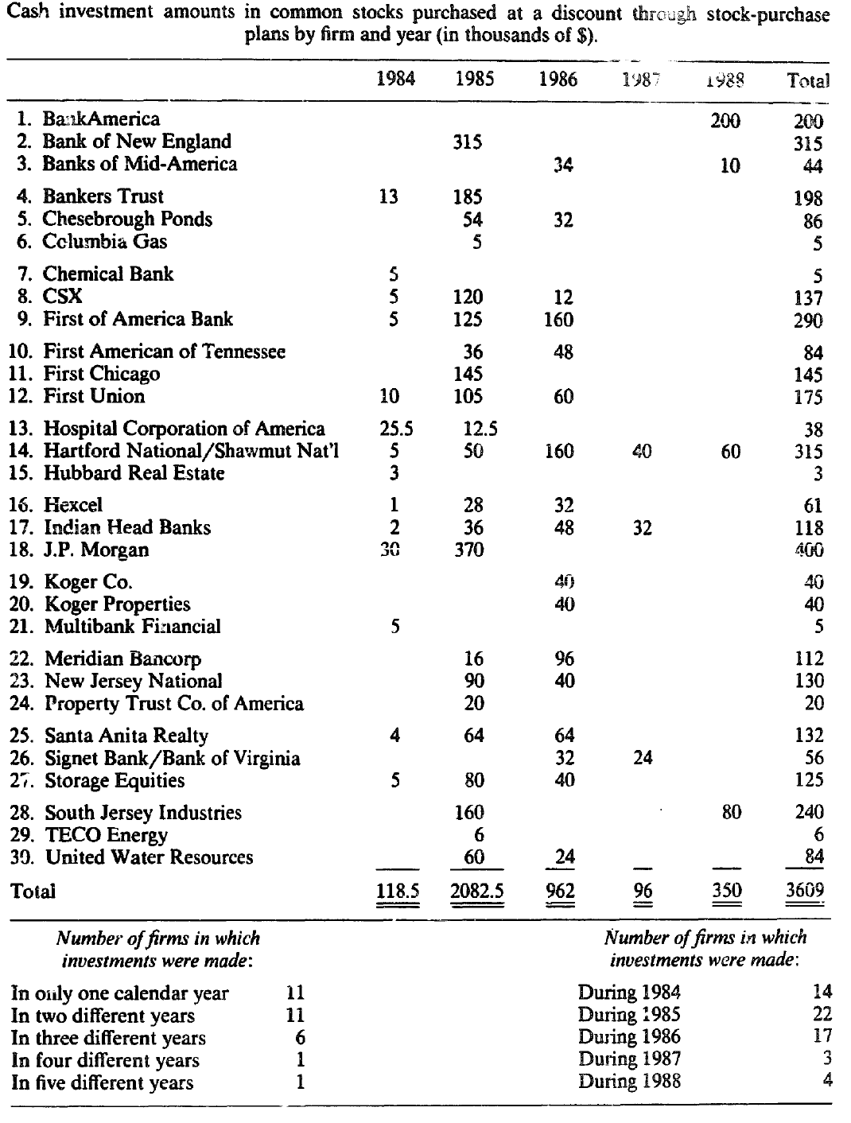
Introduction
Characteristics of
Discount DRP
Development
of Investment Program
Decentralized Investment Bank
Conclusion
Critics

Slide 21
Changes in the level of investment activity
Introduction
Reasons for the change:
Termination of some program in later years
Some programs decrease discount and ceiling down to a unprofitable level (3%)
Some execution cost are >2%, while the average is 0.5%
Some programs required considerable monitoring on discount price, some can be even negative
Change of regulation stopped them from merging into one transaction after Dec. 31 1986. (Additional cost of $15,000-$20,000)
Family tax planning: Tax Reform Act of 1986
Characteristics of
Discount DRP
Development
of Investment Program
Decentralized Investment Bank
Conclusion
Critics

Slide 22
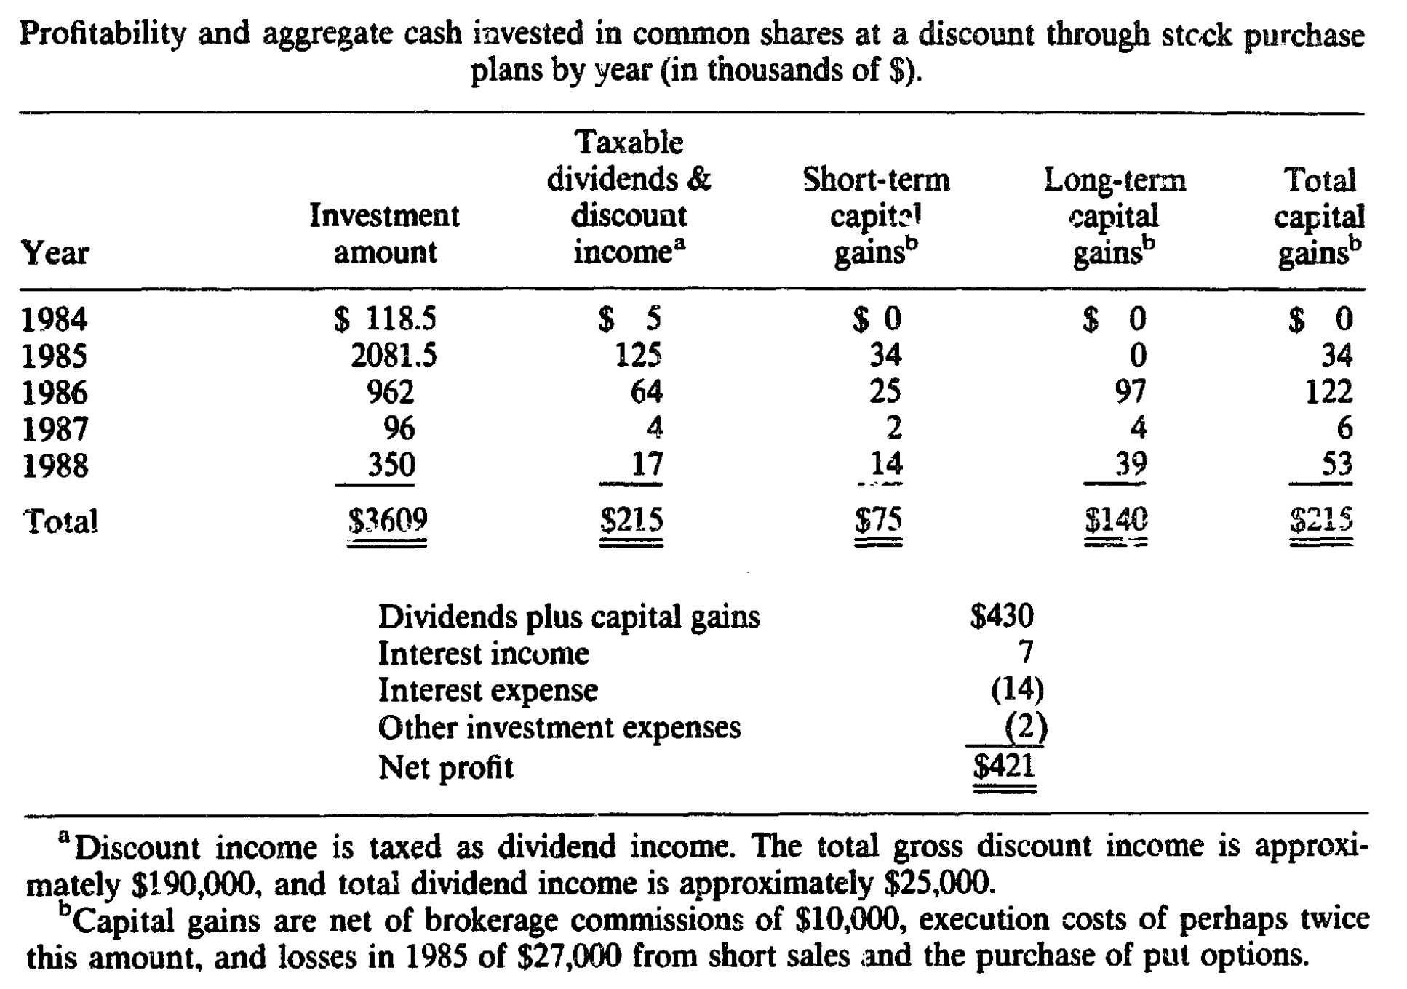
Strategy Performance
Introduction
Characteristics of
Discount DRP
Development
of Investment Program
Decentralized Investment Bank
Conclusion
Critics

Slide 23
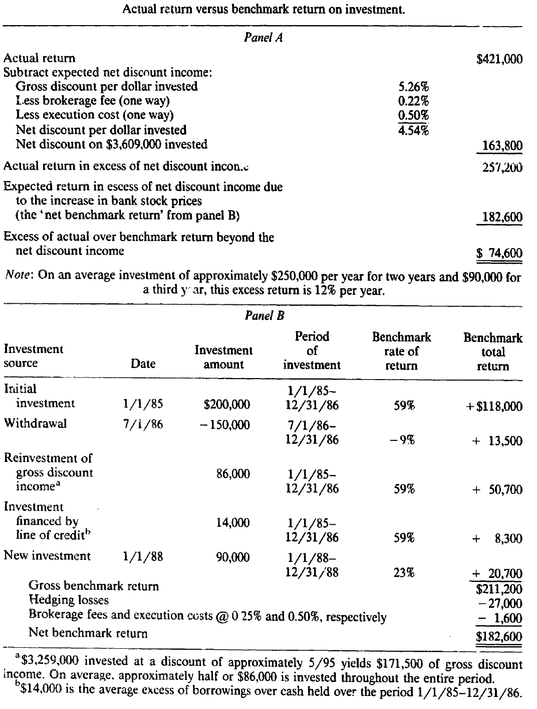
Introduction
Characteristics of
Discount DRP
Excluding the discount income, the return is 12% per year above benchmark performance.
Development
of Investment Program
Decentralized Investment Bank
Conclusion
Critics

Slide 24
How much money is raised through DSPP?
Are short term traders really welcome?
Chapter 4
Corporate finance implications
研究理论与文献综述
Decentralized
investment bank
主要创新

Slide 25
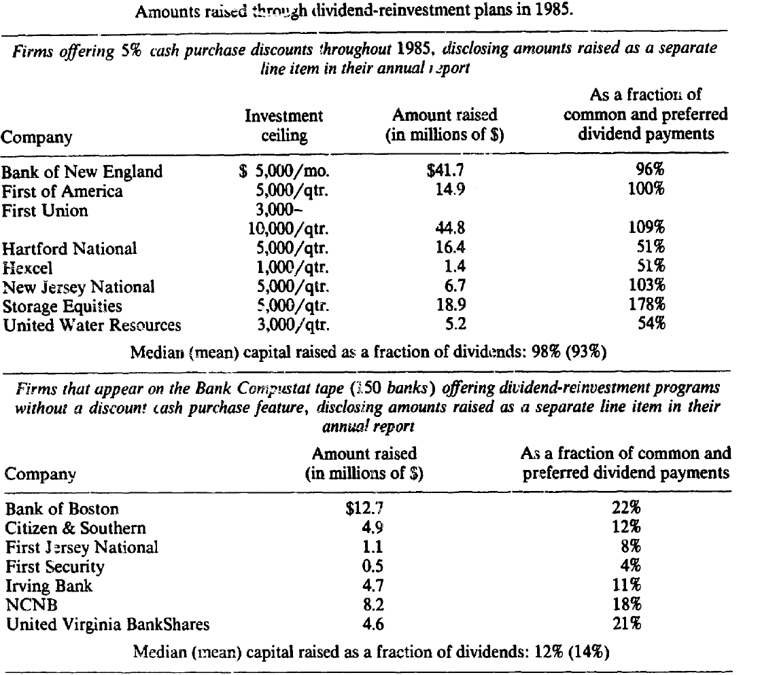
Introduction
Characteristics of
Discount DRP
Development
of Investment Program
Decentralized Investment Bank
Conclusion
Critics

Slide 26
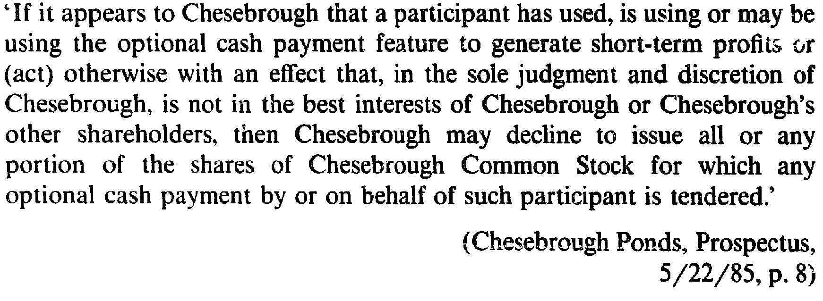
Are short term traders really welcome?
Introduction
Characteristics of
Discount DRP
Development
of Investment Program
Decentralized Investment Bank
Conclusion
Critics

Slide 27
.
Corporate finance implications
Introduction
Will the DSPP has a negative effect on stock price?
Dubofsky and Bierman (1988) is worth citing. They find, for a sample of 46 firms announcing the initiation of discount RIP between 197 and 1983, and for which no other Wall Street Journal news items were reported in the three days surrounding the DRP announcements, that common stock returns, in excess of the market, were statistically significantly positive on the announcement by an amount average of 1/3% to ½%.
While for under­ written stock and stock-rights issues, Asquith and Mullins {1983) report a -3.14% abnormal two-day return for industrial stocks and a - 0.75% abnor­mal two-day return for utilities on the announcement of new equity issues.
Characteristics of
Discount DRP
Development
of Investment Program
Decentralized Investment Bank
Conclusion
Critics

Slide 28
.
Corporate finance implications
Introduction
Why discount DSPP ?
Reduce the negative effect on stock price
Raising capital over time allows some of the information management has when the plan to raise equity is announced to be reflected in publicly disclosed account­ing measures of performance and other outlets, thereby reducing information asymmetries.
The underwriting fee goes to the shareholder instead of investment bank
The discount is almost equal to the cost of underwriting through investment bank.
Characteristics of
Discount DRP
Development
of Investment Program
Decentralized Investment Bank
Conclusion
Critics

Slide 29
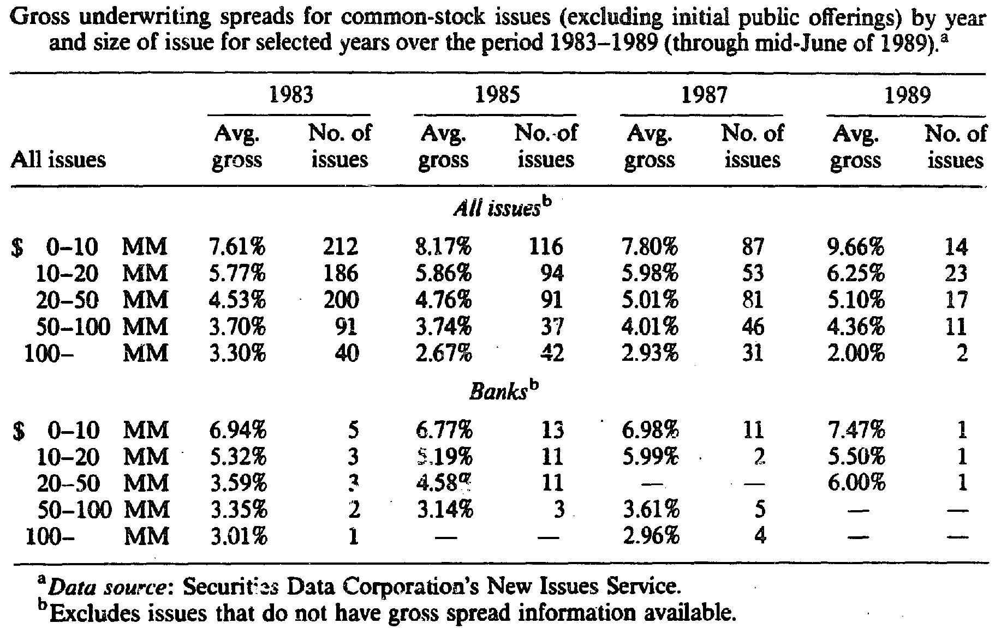
.
Corporate finance implications
Introduction
Characteristics of
Discount DRP
Development
of Investment Program
Decentralized Investment Bank
Conclusion
Critics

Slide 30
Chapter 5
Conclusion and Critics

Slide 31
.
Conclusion
Introduction
Market is not always efficient, Innovation!!
Reason for the decay of DDRIP:
5% is too generous
Firms have raised enough money
Arbitrage does not comply to firm interest
Underwriting cost of investment bank is decreasing (4.5-5% to 3.5-4%)
Benefits for DDRIP:
Reduce information asymmetry in capital raising
Benefit shareholders
Characteristics of
Discount DRP
Development
of Investment Program
Decentralized Investment Bank
Conclusion
Critics

Slide 32
Critics
Introduction
Cherry-picking of time:
From 1987-1988, the worst time with nearly no investment. Questionable
2. There might be a relationship between decreasing discount rate and worsen stock market.
3. No more free lunch:
Only very very few companies might have discounted stock-purchased plan
High registration fee, sales fee,
4. Lack of diversity of DSPP:
5. Reduced investment banking underwriting fee: 3.5%
Characteristics of
Discount DRP
Development
of Investment Program
Decentralized Investment Bank
Conclusion
Critics

Slide 33
Critics
Introduction
Characteristics of
Discount DRP
Development
of Investment Program
Decentralized Investment Bank
Conclusion
Critics

Slide 34
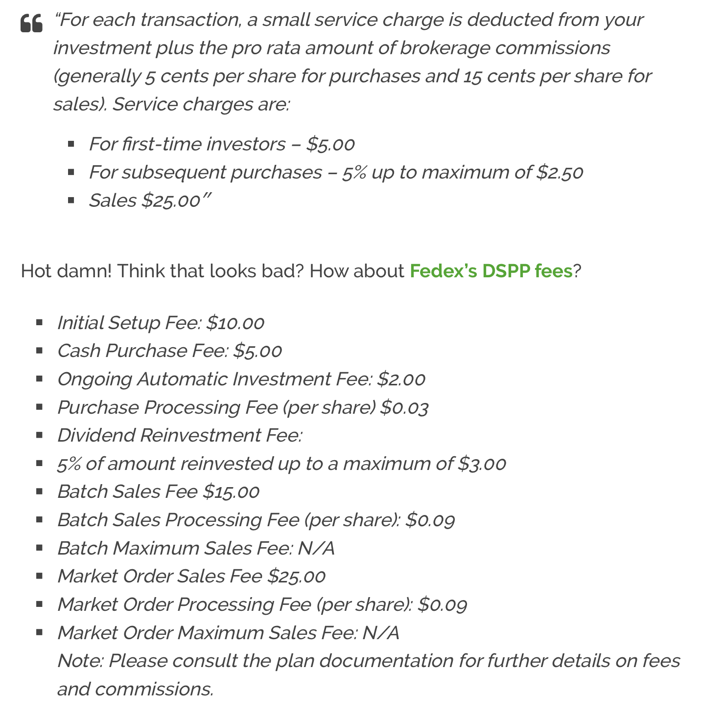
Introduction
Characteristics of
Discount DRP
Development
of Investment Program
Decentralized Investment Bank
Conclusion
Critics

